Slide 1
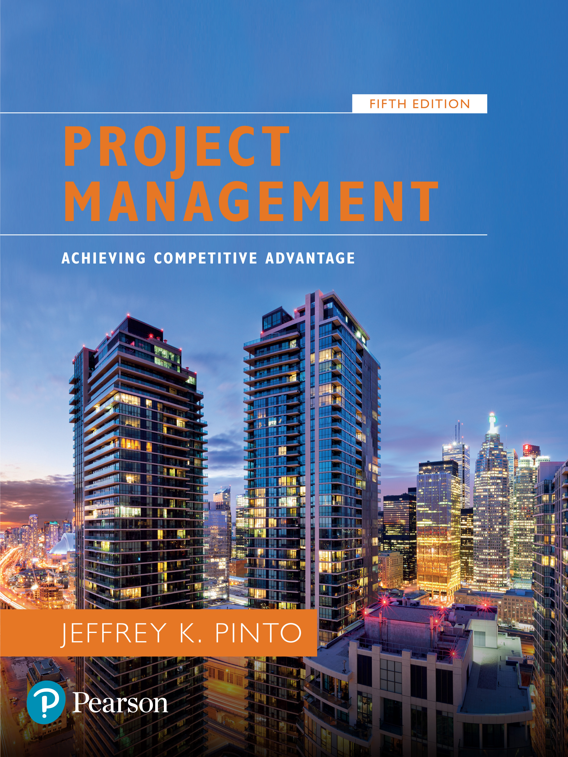
Project Management: Achieving Competitive Advantage
Fifth Edition
Chapter 5
Scope Management
Copyright © 2019, 2016, 2013 Pearson Education, Inc. All Rights Reserved
Notes:
If this PowerPoint presentation contains mathematical equations, you may need to check that your computer has the following installed:
1) MathType Plugin
2) Math Player (free versions available)
3) NVDA Reader (free versions available)

Slide 2
Learning Objectives (1 of 2)
5.1 Understand the importance of scope management for project success.
5.2 Understand how conceptual development serves as a critical first stage in scope management.
5.3 Identify the steps in developing the scope statement.
5.4 Understand the work authorization phase of scope development.

Slide 3
Project Scope
Project scope is everything about a project—work content as well as expected outcomes.
Scope management is the function of controlling a project in terms of its goals and objectives and consists of:
Conceptual development
Scope statement
Work authorization
Scope reporting
Control systems
Project closeout

Slide 4
1. Conceptual Development
The process that addresses project objectives by finding the best ways to meet them.
Key steps in information development:
Problem or need statement
Requirements gathering
Information gathering
Constraints
Alternative analysis
Project objectives
Business case

Slide 5
A. Statement of Work (S O W)
A S O W is a detailed narrative description of the work required for a project.
Effective S O W s contain:
Introduction and background
Technical description of the project
Timeline and milestones

Slide 6
Sample Statement of Work

Slide 7
B. Project Charter
Many organizations establish the project charter after the S O W.
A document issued by the project initiator or sponsor formally sanctioning existence of the project and authorizes the project manager to begin applying organizational resources to project activities.
Is created once project sponsors have done their “homework” to verify that:
there is a business case for the project
elements of project are understood
company-specific information for the project has been applied
It demonstrates formal company approval of the project.

Slide 8
2. Scope Statement
The scope statement details the project deliverables and describes the major objectives. The objectives should include measurable success criteria for the project.
Deliverables is a term for the quantifiable goods or services that will be provided upon the completion of a project.
Deliverables can be tangible or intangible parts of the development process.

Slide 9
Scope Statement
Establish project goal criteria to include:
a. cost
b. schedule
c. performance
d. deliverables
e. review and approval “gates”
Develop management plan for project
Establish a Work Breakdown Structure
Create a scope baseline

Slide 10
A. Work Breakdown Structure (W B S)
The W B S is a hierarchical decomposition of the total scope of work to be carried out by the project team to accomplish the project objectives and create the project deliverables. Each deliverable is decomposed, or broken down, into specific “bite-sized” pieces representing work to be completed.

Slide 11
Work Breakdown Structure Purpose
W B S serves six main purposes:
Echoes project objectives
Organization chart for the project
Creates logic for tracking costs, schedule, and performance specifications
Communicates project status
Improves project communication
Demonstrates control structure

Slide 12
B. Defining a Work Package
Lowest level in W B S
Deliverable result
One owner
Miniature projects
Milestones
Fits organization
Trackable

Slide 13
C. Responsibility Assignment Matrix
Assigning each task to a team member.

Slide 14

Work Authorization
The formal “go ahead” to begin work.
Contractual documentation possesses some key identifiable features:
Contractual requirements
Valid consideration
Contracted terms
Contracts range from:

Slide 15
Scope Reporting
Determines what types of information reported, who receives copies, and when and how information is acquired and disseminated.
Typical project reports contain:
Cost status
Schedule status
Technical performance status

Slide 16
Types of Control Systems
Configuration control-check whether objectives are being adhered to.
Design control- check whether initial design is being followed
Trend monitoring-check cost and schedule against resources required

Slide 17
Types of Control
Document control-check compilation and dissemination of documentation.
Acquisition control- checks on project equipment, materials and services
Specification control-project specification has been clearly prepared and communicated to all parties.

Slide 18
Project Changes (Variation)
Occur for one of several reasons:
Initial planning errors, either technological or human
Additional knowledge of project or environmental conditions
Uncontrollable mandates
Client requests

Slide 19
Project Closeout
The job is not over until the paperwork is done . . .
Closeout documentation is used to:
Resolve disputes
Train project managers
Facilitate auditing
Closeout documentation includes:
Historical records
Post-project analysis
Financial closeout

Slide 20
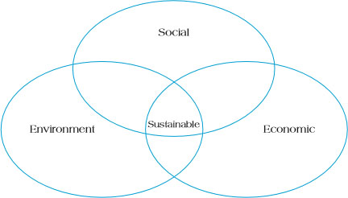
Sustainability
Sustainable development involves efforts to promote harmony among human beings and between humanity and nature.
Sustainability involves efforts to promote the triple bottom line of social sustainability, environmental sustainability, and economic sustainability.
Figure 5.12 The Triple Bottom Line of Sustainability

Slide 21
Sustainability Concepts
Sustainability is about:
Harmonizing the triple bottom line
Integrating short-term and long-term
Consuming income, not capital
Including local and global perspectives
Values and ethics
Transparency and accountability
Stakeholder participation
Risk reduction
Waste elimination

Slide 22
Sustainable Project Management Practices
Project management sustainable practices include:
Engaging in sustainable projects that will not cause harm to the planet or its inhabitants
Employing sustainable practices while undertaking the projects themselves
Developing sustainable supplier practices
Emphasizing sustainability in project design
Sustainable project management practices require organizations to pay attention to all aspects of the project life cycle from conceptualization through termination.

Slide 23
Thank you

